Slide 1
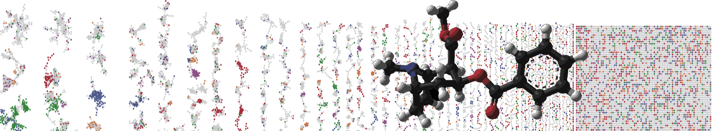


GNPS Molecular Networking Enhancer
Hands On
MADELEINE ERNST
MAURICIO CARABALLO
MINGXUN WANG
University of California - San Diego

Slide 2
GNPS Documentation
Classical Molecular Network
https://ccms-ucsd.github.io/GNPSDocumentation/networking/
Network Annotation Propagation
https://ccms-ucsd.github.io/GNPSDocumentation/nap/
Dereplicator
https://ccms-ucsd.github.io/GNPSDocumentation/dereplicator/
MolNetEnhancer
https://ccms-ucsd.github.io/GNPSDocumentation/molnetenhancer/

Slide 3
MolNetEnhancer
Ernst et al., Metabolites 2019, 9(7), 144
Tutorials to get familiar with individual tools from which the output is combined with MolNetEnhancer can be found here:
GNPS molecular networking:
https://ccms-ucsd.github.io/GNPSDocumentation/networking
DEREPLICATOR/VarQuest:
https://ccms-ucsd.github.io/GNPSDocumentation/dereplicator
Network annotation propagation:
https://ccms-ucsd.github.io/GNPSDocumentation/nap
ClassyFire:
http://classyfire.wishartlab.com
MS2LDA:
https://ccms-ucsd.github.io/GNPSDocumentation/ms2lda/
http://ms2lda.org/user_guide
MolNetEnhancer workflow tutorials in both R and Python can be found here:
https://github.com/madeleineernst/pyMolNetEnhancer
https://github.com/madeleineernst/RMolNetEnhancer

Slide 4
Related publications
MolNetEnhancer
https://www.mdpi.com/2218-1989/9/7/144
Reproducible molecular networking of untargeted mass spectrometry data using GNPS
https://www.nature.com/articles/s41596-020-0317-5
Dereplicator
https://www.nature.com/articles/nchembio.2219
Dereplicator/VarQuest
https://www.nature.com/articles/s41564-017-0094-2
Dereplicator+
https://www.nature.com/articles/s41467-018-06082-8
Network annotation propagation:
https://journals.plos.org/ploscompbiol/article?id=10.1371/journal.pcbi.1006089
ClassyFire:
https://jcheminf.biomedcentral.com/articles/10.1186/s13321-016-0174-y
MS2LDA:
https://pubs.acs.org/doi/10.1021/acs.analchem.7b01391

Slide 5
What do we need?
Molecular Network Job
https://gnps.ucsd.edu/ProteoSAFe/status.jsp?task=4337bd3ce4a1444bb70fe2e7d22231a9
Network Annotation Propagation Job
https://proteomics2.ucsd.edu/ProteoSAFe/status.jsp?task=ae3a9ddfeddf4f03b68d09be083a8916
Dereplicator Job
https://gnps.ucsd.edu/ProteoSAFe/status.jsp?task=d61bd3df34214836bc174f0241a12e00

Slide 6
Classical Molecular Network
https://ccms-ucsd.github.io/GNPSDocumentation/networking/
GNPS - Amycolatopsis sp AA4 - small dataset
MSV000085153
Link to the GNPS job:
https://gnps.ucsd.edu/ProteoSAFe/status.jsp?task=4337bd3ce4a1444bb70fe2e7d22231a9

Slide 7
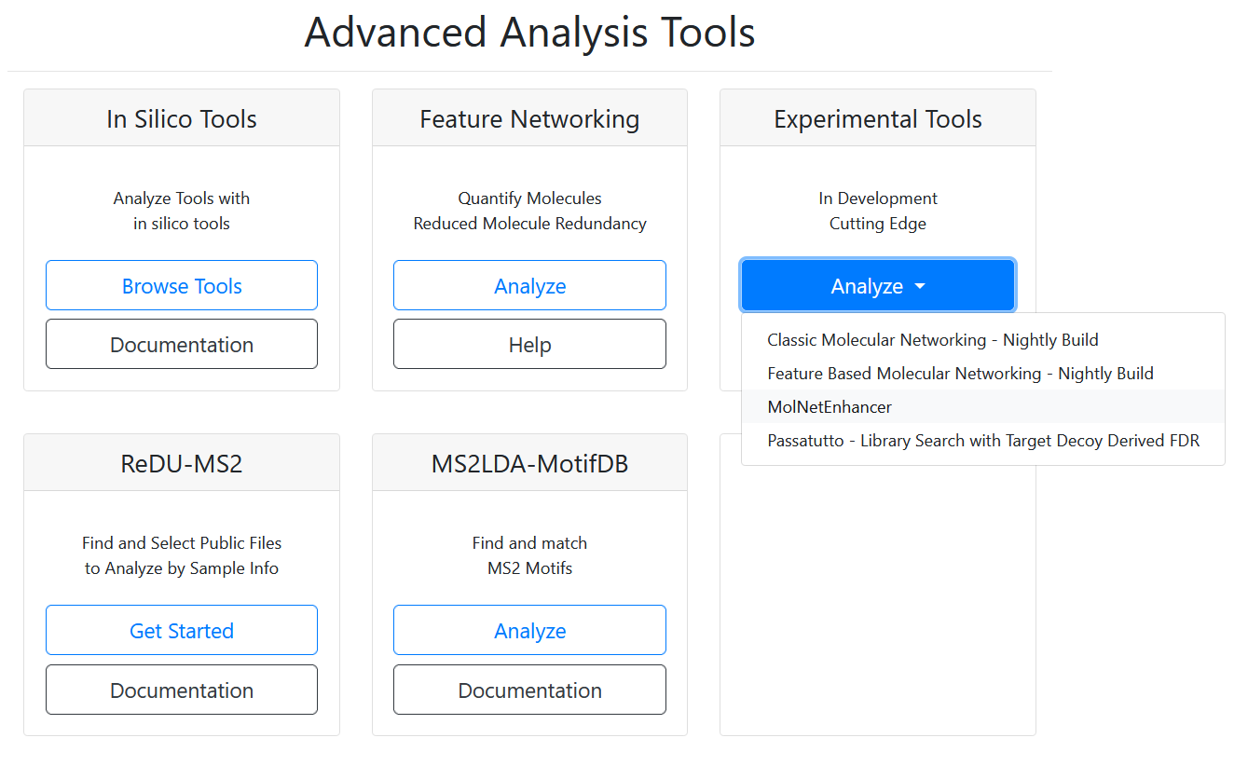

Slide 8
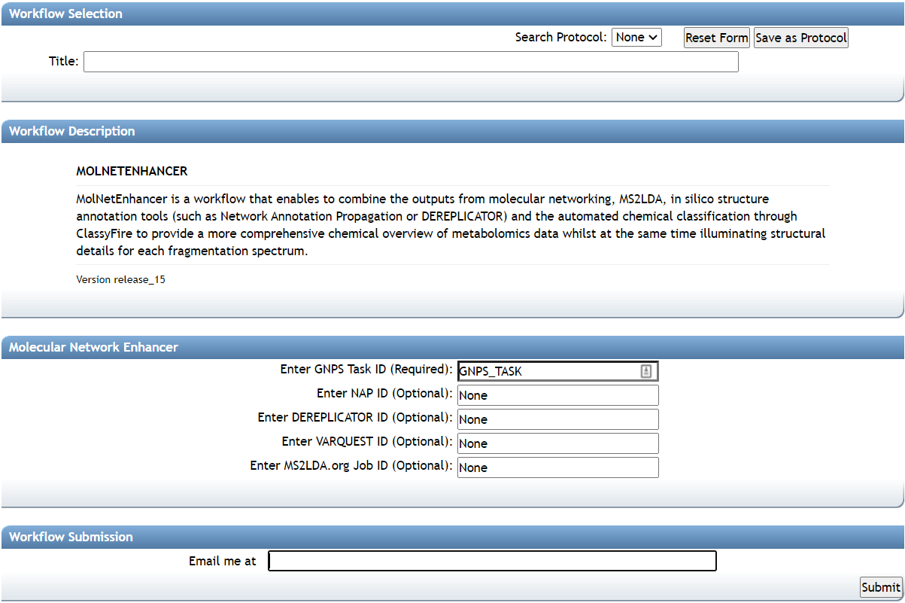

Slide 10
GNPS - Amycolatopsis sp AA4 - small dataset
Link to the GNPS job:
https://gnps.ucsd.edu/ProteoSAFe/status.jsp?task=4337bd3ce4a1444bb70fe2e7d22231a9
4337bd3ce4a1444bb70fe2e7d22231a9

Slide 12
GNPS - Amycolatopsis sp AA4 - small dataset
Link to NAP job:
https://proteomics2.ucsd.edu/ProteoSAFe/status.jsp?task=ae3a9ddfeddf4f03b68d09be083a8916
ae3a9ddfeddf4f03b68d09be083a8916

Slide 14
GNPS - Amycolatopsis sp AA4 - small dataset
Link to Dereplicator job:
https://gnps.ucsd.edu/ProteoSAFe/status.jsp?task=d61bd3df34214836bc174f0241a12e00
d61bd3df34214836bc174f0241a12e00

Slide 15
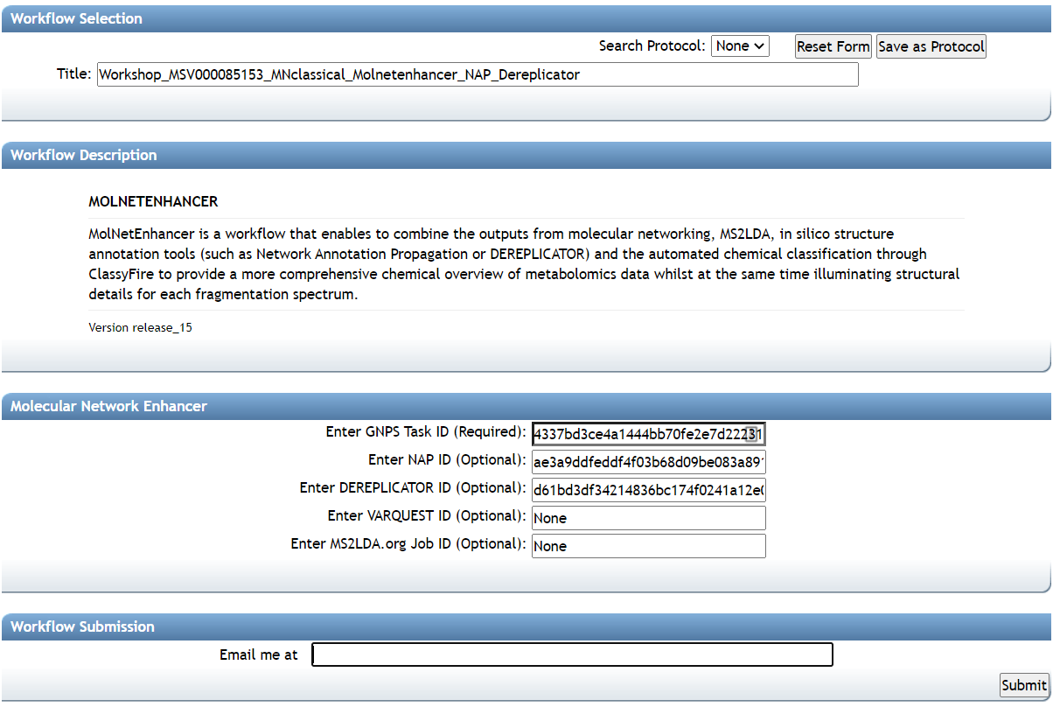

Slide 17
GNPS - Amycolatopsis sp AA4 - small dataset
Link to the MolNetEnhancer job:
https://gnps.ucsd.edu/ProteoSAFe/status.jsp?task=61dbde6283d9416f96e7fda3f338e811

Slide 18
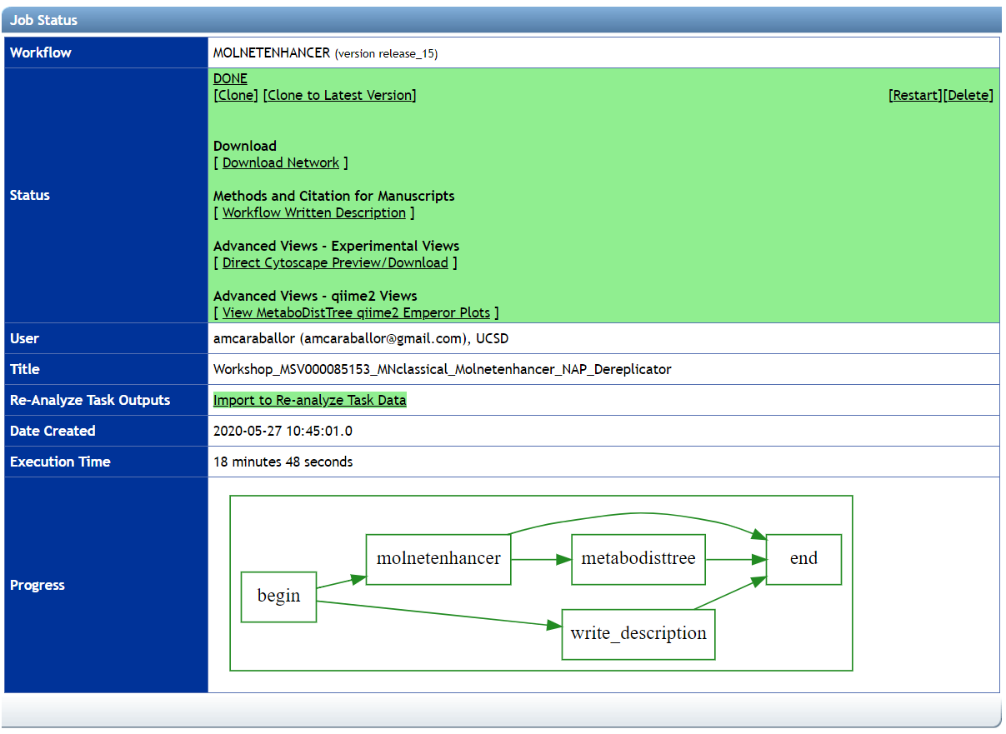

Slide 20
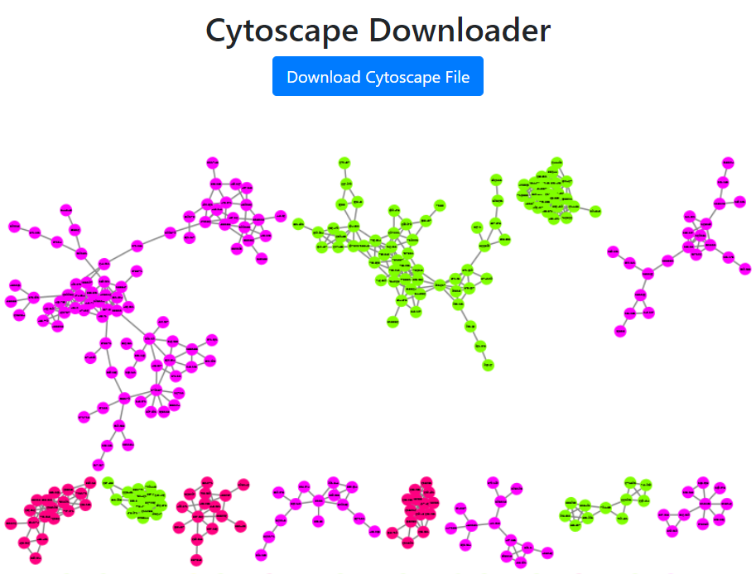

Slide 21
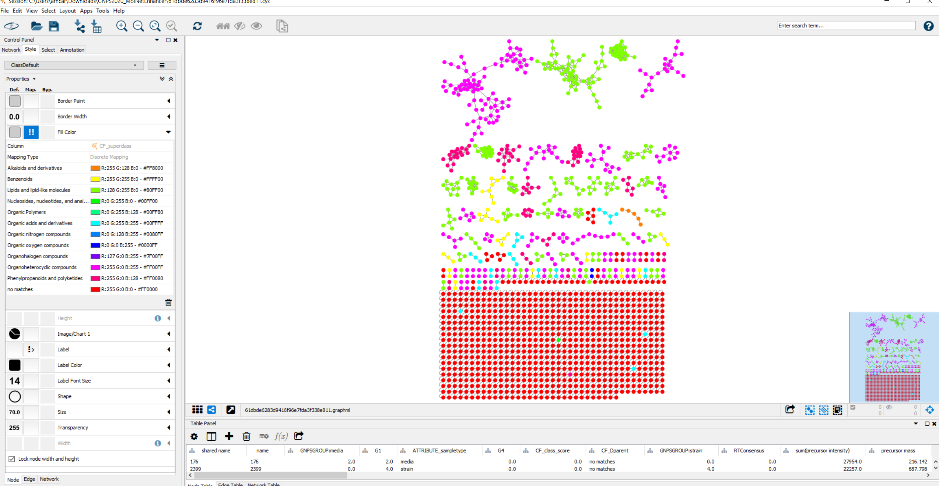
Explore your Molecular Network in Cytoscape

Slide 22
Questions, Problems or Bugs?
Documentation: https://ccms-ucsd.github.io/GNPSDocumentation/
Forum: https://groups.google.com/forum/#!forum/molecular_networking_bug_reports
Mauricio Caraballo
amcaraballor@ucsd.edu
Mingxun Wang
miw023@ucsd.edu

